Slide 1
Module 8 Part 2 Architectures for the Cloud -2
Harvinder S Jabbal
SE ZG651/ SS ZG653 Software Architectures

Slide 2
Architectures for the Cloud - 2

Slide 3
Session Outline
Base Mechanisms
Sample Technologies
Architecting in a Cloud Environment
Summary

Slide 4
Basic Mechanisms
Hypervisor
Virtual Machine
File system
Network

Slide 5
Virtual Memory Page Table

Slide 6
Hypervisor Manages Virtualization
Host Server
VM_{n}
VM₁
next instruction
Page
Table
Page
Table
Hypervisor
Target address of next instruction
CPU
Host Page table points to VM page table

Slide 7
Virtual Machine
A virtual machine has an address space isolated from any other virtual machine.
Looks like a bare metal machine from the application perspective.
Assigned an IP address and has network capability.
Can be loaded with any operating system or applications that can execute on the processor of the host machine.

Slide 8
File System
Each virtual machine has access to a file system.
We will present HDFS (Hadoop Distributed File System) – a widely used open source cloud file system.
We describe how HDFS uses redundancy to ensure availability.

Slide 9
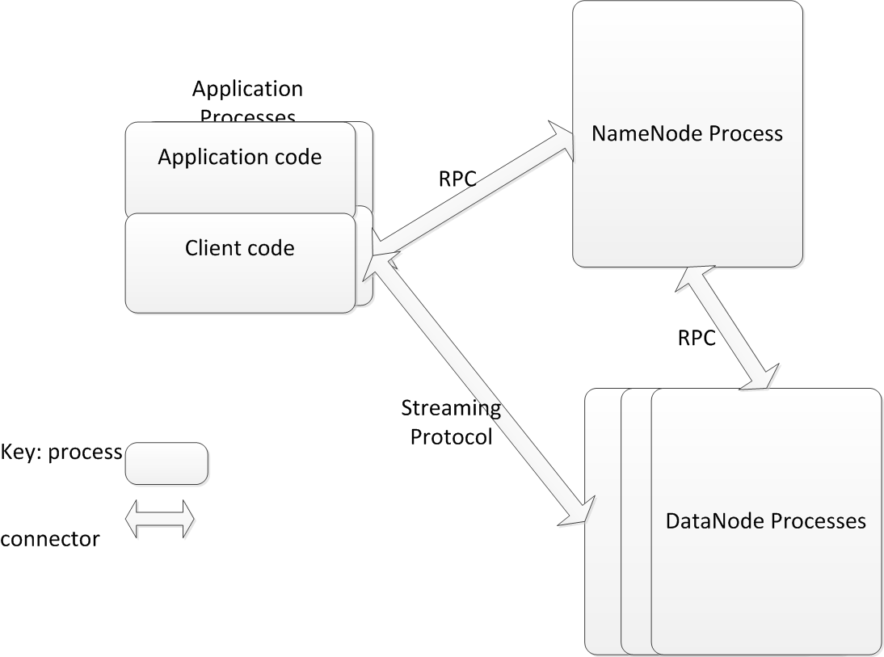
HDFS Components

Slide 10
HDFS Write – Sunny Day Scenario
Application writes as to any file system
Client buffers until it gets 64K block
Client informs NameNode it wishes to write a new block
NameNode returns list of three DataNodes to hold block
Client sends block to first DataNode and informs DataNode of other two replicas.
First DataNode writes block and sends it to second DataNode. Second DataNode writes block and sends it to last DataNode.
Each DataNode reports to client when it has completed its write
Client commits write to NameNode when it has heard from all three DataNodes.

Slide 11
HDFS Write – Failure Cases
Client fails
Application detects and retries
Write is not complete until committed by Client
NameNode fails
Backup NameNode takes over
Log file maintained to avoid losing information
DataNodes maintain true list of which blocks they each have
Client detects and retries
DataNode fails
Client (or earlier DataNode in pipeline) detects and asks NameNode for different DataNode.
Since each block is replicated three times, a failure in a DataNode does not lose any data.

Slide 12
Network
Every Virtual Machine is assigned an IP address.
Every message using TCP/IP includes IP address in header.
Gateway for cloud can adjust IP address for various purposes.

Slide 13
Sample Technologies
IaaS
PaaS
DataBases

Slide 14
IaaS
An arrangement of servers that manages the base technologies.
Servers are arranged in clusters
May be thousands of servers in a cluster
Some servers are used as the infrastructure of the IaaS
Every server has a hypervisor as its base.

Slide 15
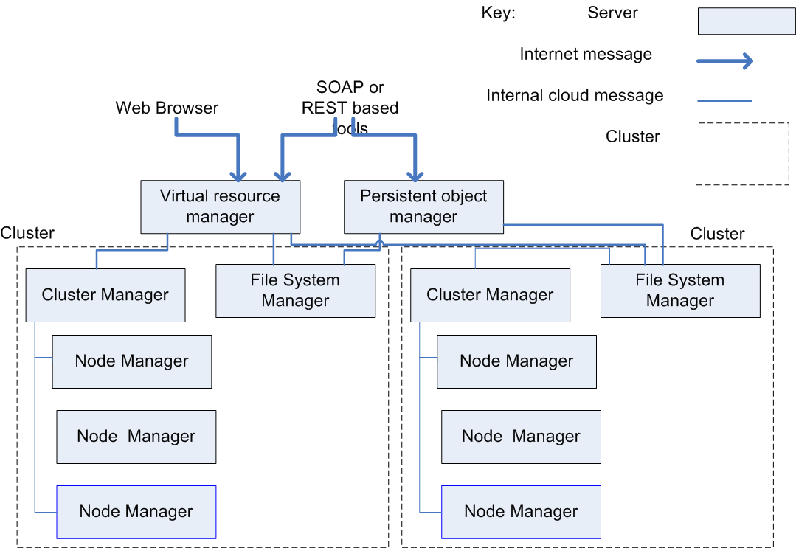
IaaS Architecture
IaaS Architecture

Slide 16
IaaS Architecture Components
Cluster Manager responsible for managing each cluster
Persistent Object Manager manages persistence
Virtual Resource Manager manages other resources. It acts as a gateway for messages.
The File System Manager is similar to HDFS. It manages the network wide file system.

Slide 17
Services Provided by IaaS
Automatic reallocation of IP addresses in the case of a failure of the underlying virtual machine instance.
Automatic Scaling. Create or delete new virtual machines depending on load.

Slide 18
PaaS
Provides an integrated stack for developer.
E.g. LAMP stack
Linux, Apache, MySQL, Python
The developer writes code in Python and the PaaS manages assignment to underlying layers of the stack.

Slide 19
Databases
Why relational databases came into question
Massive amounts of data are collected from web systems. Much of this data is processed sequentially and so RDBMSs introduce overhead, especially during creation and maintenance.
The CAP Theorem shows that it is not possible to simultaneously achieve consistency, availability, and partitioning.
The relational model is not the best model for some applications.
Caused the introduction of new data models
Key-value
Document centric

Slide 20
Key Value – HBase
One column designated as a key. The others are all values
No schema so data can have key + any other values. The values are identified by their variable name.
Data values are also time stamped
Hbase does not support transactions. Time stamps are used to detect collisions after the fact.

Slide 21
Document Centric – MongoDB
Stores objects rather than data
Access data through containing object
Objects can also contain links to other objects
No concept of primary or secondary index. A field is indexed or it is not.

Slide 22
What is Omitted From These DBs
Transactions. No locking is performed. The application must detect interference with other users.
Schemas. No predefined schemas. The application must use correct name.
Consistency. The CAP theorem says something must give. Usually consistency is replaced by “eventual consistency”
Normalization and Joins. Performing a join requires that the join field is indexed. Because there is not a guaranteed index field, joins cannot be performed. This means normalization of tables is not supported.

Slide 23
Architecting in a Cloud Environment
Quality attributes that are different in a cloud
Security
Performance
Availability

Slide 24
Security
Multi-tenancy introduces additional concerns over non-cloud environments.
Inadvertent information sharing. Possible that information may be shared because of shared use of resources. E.g. information on a disk may remain if the disk is reallocated.
A virtual machine “escape”. One user can break the hypervisor. So far, purely academic.
Side channel attacks. One user can detect information through monitoring cache, for example. Again, so far, purely academic.
Denial of Service attacks. One users can consume resources and deny them to other users.
Organizations need to consider risks when deciding what applications to host in the cloud.

Slide 25
Performance
Auto-scaling provides additional performance when load grows.
Response time for new resources may not be adequate
Architects need to be aware of resource requirements for applications
Build that knowledge into the applications
May applications self aware so that they can be proactive with respect to resource needs.

Slide 26
Availability
Failure is a common occurrence in the cloud
With 1000s of servers, failure is to be expected
Cloud providers ensure that the cloud itself will remain available with some notable exceptions.
Application developers must assume instances will fail and build in detection and correction mechanisms in case of failure.

Slide 27
Summary
The cloud provides a new platform for applications with some different characteristics.
Architect needs to know how a cloud cluster works and pay special attention to
Security
Performance
Availability

